Slide 1
Cornerstone City Church Peninsula Plus Community Hoo Are Ya
^{15th} June 2025

Slide 2


Slide 3
Nothing Is Impossible
CCLI Song # 5199808
Joth Hunt
© 2008 Planetshakers Ministries Int. Inc. (Admin. by Song Solutions www.songsolutions.org)
For use solely with the SongSelect® Terms of Use. All rights reserved. www.ccli.com
CCLI Licence No. 33265

Slide 4
1/7
Through You I can do anything
I can do all things
'Cause it's You who gives me strength
Nothing is impossible
Through You blind eyes are open
Strongholds are broken
I am living by faith
Nothing is impossible

Slide 5
2/7
I'm not gonna live by what I see
I'm not gonna live by what I feel Deep down I know that
You're here with me
And I know that
You can do anything

Slide 6
3/7
Through You I can do anything
I can do all things
'Cause it's You who gives me strength
Nothing is impossible
Through You blind eyes are open
Strongholds are broken
I am living by faith
Nothing is impossible

Slide 7
4/7
I'm not gonna live by what I see
I'm not gonna live by what I feel Deep down I know that
You're here with me
And I know that
You can do anything

Slide 8
5/7
Through You I can do anything
I can do all things
'Cause it's You who gives me strength
Nothing is impossible
Through You blind eyes are open
Strongholds are broken
I am living by faith
Nothing is impossible

Slide 9
6/7
I believe I believe
I believe I believe in You
(REPEAT)

Slide 10
7/7
Through You I can do anything
I can do all things
'Cause it's You who gives me strength
Nothing is impossible
Through You blind eyes are open
Strongholds are broken
I am living by faith
Nothing is impossible

Slide 11
Open The Eyes of My Heart
CCLI Song # 2298355
Paul Baloche
© 1997 Integrity's Hosanna! Music (Admin. by Integrity Music Ltd)
For use solely with the SongSelect® Terms of Use. All rights reserved. www.ccli.com
CCLI Licence No. 33265

Slide 12
1/3
Open the eyes of my heart Lord
Open the eyes of my heart
I want to see You
I want to see You

Slide 13
2/3
To see You high and lifted up
Shining in the light of Your glory
Pour out Your power and love
As we sing holy holy holy

Slide 14
3/3
Holy holy holy
Holy holy holy
Holy holy holy
I want to see You

Slide 16
Way Maker CCLI Song # 7115744
Osinachi Kalu Okoro Egbu
© 2016 Integrity Music Europe (Admin. by Integrity Music)
For use solely with the SongSelect® Terms of Use. All rights reserved. www.ccli.com
CCLI Licence No. 33265

Slide 17
1/4
You are here moving in our midst I worship You I worship You You are here working in this place I worship You I worship You
(You are) Way Maker Miracle Worker Promise Keeper Light in the darkness my God that is who You are

Slide 18
2/4
You are here touching ev'ry heart I worship You I worship You You are here healing ev'ry heart I worship You I worship You
(You are) Way Maker Miracle Worker Promise Keeper Light in the darkness my God that is who You are

Slide 19
3/4
You are here turning lives around I worship You I worship You You are here mending ev'ry heart I worship You yeah I worship You Lord
(You are) Way Maker Miracle Worker Promise Keeper Light in the darkness my God that is who You are

Slide 20
4/4
That is who You are x4
Even when I don't see it You're working Even when I don't feel it You're working You never stop You never stop working x2

Slide 21
How Great Is Our God
CCLI Song # 4348399
Chris Tomlin | Ed Cash | Jesse Reeves
© 2004 sixsteps Music (Admin. by Integrity Music Ltd)
Vamos Publishing (Admin. by Integrity Music Ltd)
worshiptogether.com songs (Admin. by Integrity Music Ltd)
Wondrously Made Songs (Admin. by Song Solutions www.songsolutions.org)
For use solely with the SongSelect® Terms of Use. All rights reserved. www.ccli.com
CCLI Licence No. 33265

Slide 22
1/6
The splendour of the King
Clothed in majesty
Let all the earth rejoice
All the earth rejoice
He wraps Himself in light
And darkness tries to hide
And trembles at His voice
And trembles at His voice

Slide 23
2/6
How great is our God
Sing with me
How great is our God
And all will see how great
How great is our God

Slide 24
3/6
And age to age He stands
And time is in His hands
Beginning and the End
Beginning and the End
The Godhead three in one
Father Spirit Son
The Lion and the Lamb
The Lion and the Lamb

Slide 25
4/6
How great is our God
Sing with me
How great is our God
And all will see how great
How great is our God

Slide 26
5/6
Name above all names
Worthy of all praise
My heart will sing
How great is our God

Slide 27
6/6
How great is our God
Sing with me
How great is our God
And all will see how great
How great is our God

Slide 28
1/1
Then sings my soul my Saviour God to Thee
How great Thou art how great Thou art
Then sings my soul my Saviour God to Thee
How great Thou art how great Thou art

Slide 29
1/2
Come on and praise the Lord with me
Sing if you love His name
Come on and lift your voice with me
He’s worthy of all our praise

Slide 30
2/2
Come on and bring your offering
Sing if you’ve known His grace
Come on and lift up your holy hands
He’s worthy of all our praise

Slide 32
Worthy Of it All
CCLI Song # 6280644
David Brymer | Ryan Hall
© 2012 Common Hymnal Publishing (Admin. by Integrity Music Ltd)
Innerland (Admin. by Integrity Music Ltd)
Underground Treasure (Admin. by Integrity Music Ltd)
Wayfinder Music (Admin. by Integrity Music Ltd)
For use solely with the SongSelect® Terms of Use. All rights reserved. www.ccli.com
CCLI Licence No. 33265

Slide 33
1/4
All the saints and angels
Bow before Your throne
All the elders cast their crowns
Before the Lamb of God and sing

Slide 34
2/4
You are worthy of it all
You are worthy of it all
For from You are all things
And to You are all things
You deserve the glory

Slide 35
3/4
Day and night,
Night and day,
Let incense arise
(X4)
Day and night
Night and day

Slide 36
4/4
You are worthy of it all
You are worthy of it all
For from You are all things
And to You are all things
You deserve the glory

Slide 38


Slide 39
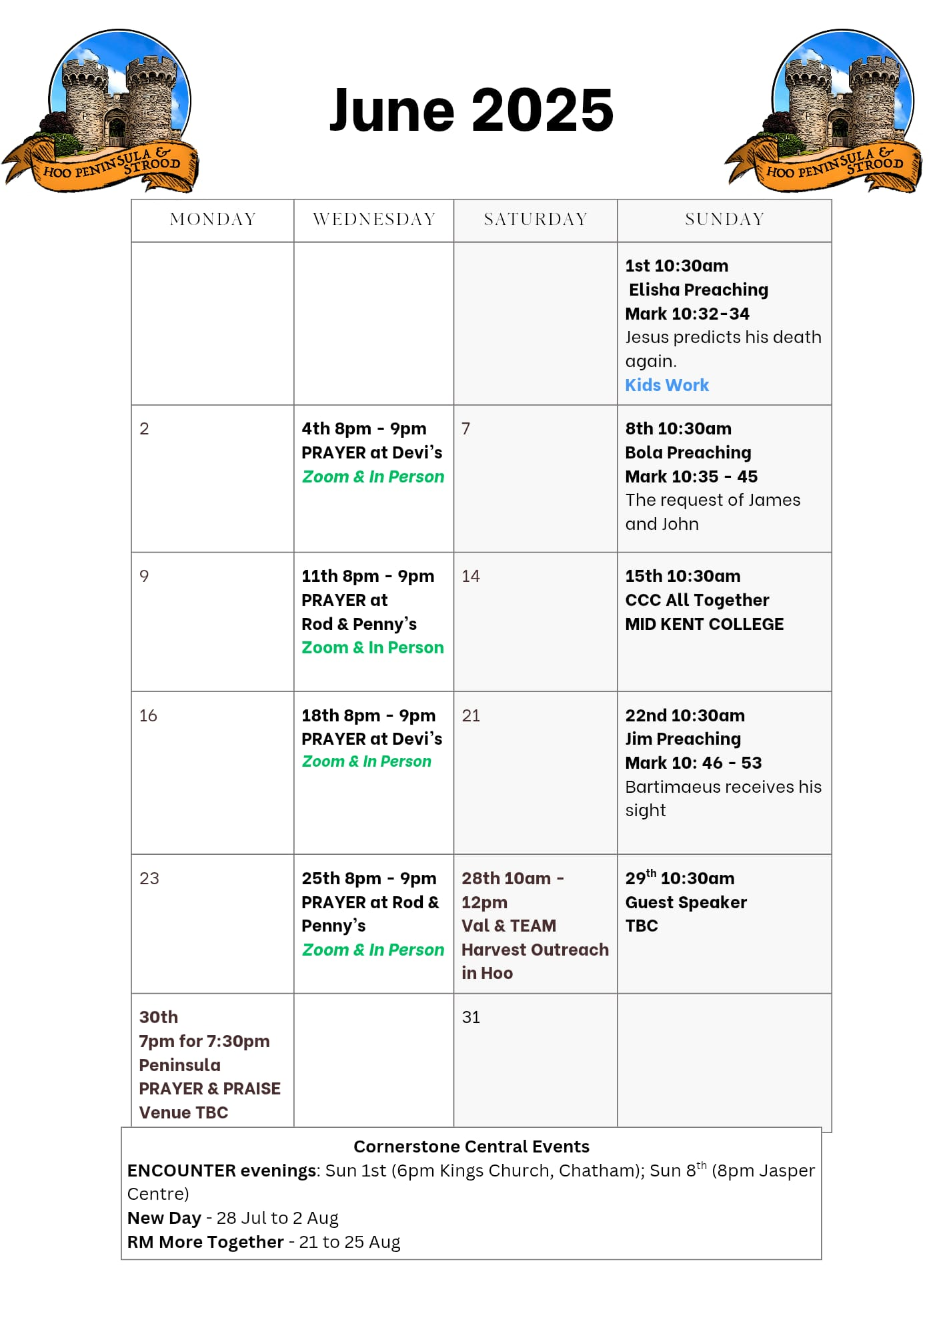

Slide 40


Slide 41


Slide 42

Grow Group 1
On YOUR MARK!

Slide 43
Leaders
Leaderss
Phil & Kim
Maria (Mia) Warren
Matthew Harrison
Richard & Elisha Acheampong
Phil & Kim
Maria (Mia) Warren
Matthew Harrison
Richard & Elisa Acheampong

Slide 44

Storm Walker
Storm Walker
Symbolising, trust in Jesus Christ through life's storms.
Mark 4:35-41

Slide 45


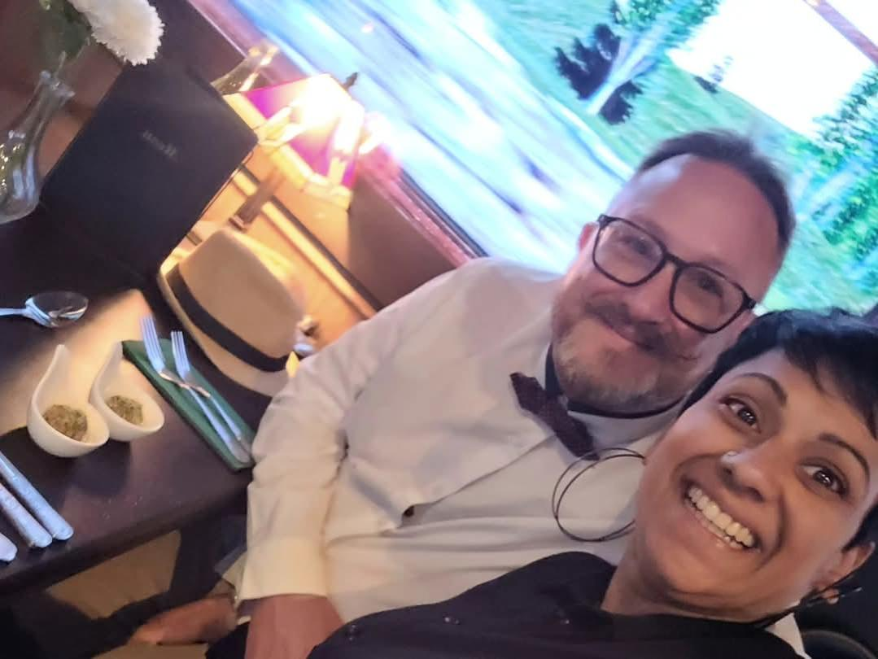
Group Leaders
Micheal and Mwamba
Wilfred and Parveen
Hannah

Slide 46


Slide 47
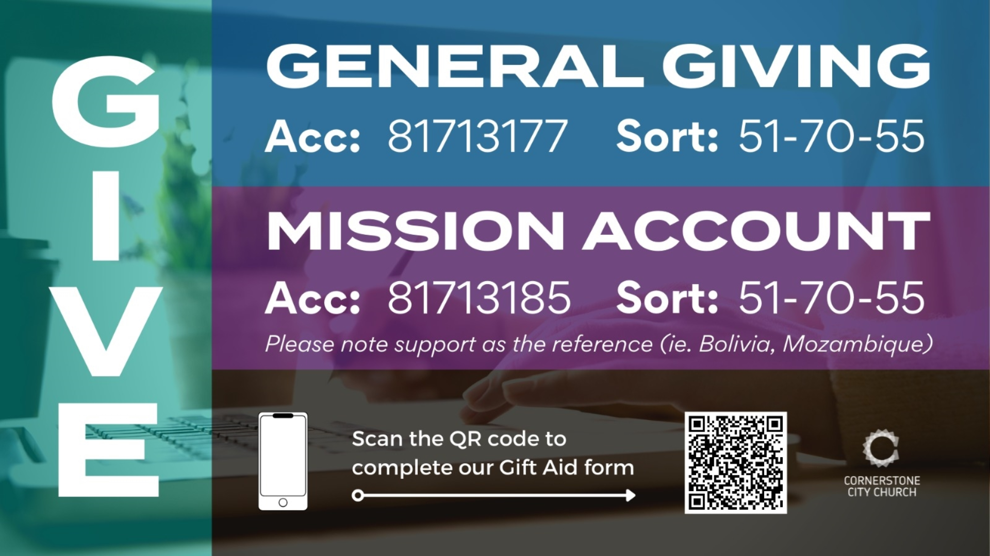

Slide 48


Slide 49
2 Corinthians 14 May the grace of the Lord Jesus Christ, and the love of God, and the fellowship of the Holy Spirit be with you all
Surely goodness and mercy shall follow me all the days of my life, and I shall dwell in the house of the Lord forever.

Slide 51
Bless God
CCLI Song # 7206380
Brandon Lake | Brooke Ligertwood | Cody Carnes
© 2023 Brandon Lake Music; Brooke Ligertwood Designee; Capitol CMG Paragon; Writer's Roof Publishing
For use solely with the SongSelect® Terms of Use. All rights reserved. www.ccli.com

Slide 52
1/11
Blessed are those who run to Him
Who place their hope and confidence in Jesus
He won’t forsake them
Blessed are those who seek His face
Who bend their knee and fix their gaze on Jesus
They won’t be shaken

Slide 53
2/11
Come on and praise the Lord with me
Sing if you love His name
Come on and lift your voice with me
He’s worthy of all our praise

Slide 54
3/11
Blessed are those who walk with Him
Whose hearts are set on pilgrimage with Jesus
They’ll see His glory
Blessed are those who die to live
Whose joy it is to give it all for Jesus
And for Him only
Oh Jesus all for Your glory

Slide 55
4/11
Come on and praise the Lord with me
Sing if you love His name
Come on and lift your voice with me
He’s worthy of all our praise

Slide 56
5/11
Come on and bring your offering
Sing if you’ve known His grace
Come on and lift up your holy hands
He’s worthy of all our praise

Slide 57
6/11
Bless God in the sanctuary
Bless God in the fields of plenty
Bless God in the darkest valley
Every chance I get I bless Your name

Slide 58
7/11
Bless God when my hands are empty
Bless God with a praise that costs me
Bless God when nobody’s watching
Every chance I get I bless Your name

Slide 59
8/11
Bless God when the weapon’s forming
Bless God when the walls are falling
Bless God ‘cause He goes before me
Every chance I get I bless Your name

Slide 60
9/11
Bless God for He holds the vict’ry
Bless God for He’s always with me
Bless God for He’s always worthy
Every chance I get I bless Your name
Every chance I get I bless Your name

Slide 61
10/11
Come on and praise the Lord with me
Sing if you love His name
Come on and lift your voice with me
He’s worthy of all our praise

Slide 62
11/11
Come on and bring your offering
Sing if you’ve known His grace
Come on and lift up your holy hands
He’s worthy of all our praise He’s worthy of all our praise

